Slide 1
Some Technology Trends in the DNS
Geoff Huston
October 2020

Slide 2
Three broad topics:
DNSSEC
DNS Privacy
Other Stuff

Slide 3
1. DNSSEC – Why?
How can you believe what the DNS tells you?
  You can’t!
DNS interception and rewriting is common these days
  “Clean Feed” DNS resolvers
  NXDOMAIN rewriters
  DNS 6to4 rewriters
And then there is hostility
  Glue attacks (Kaminsky attack)
  Fragmentation attacks

Slide 4
1. DNSSEC – How?
Add a digital signature to the entries in the DNS zone
Provide the signature along with the resource records in the answer
Validate the signature before using the response data

Slide 5
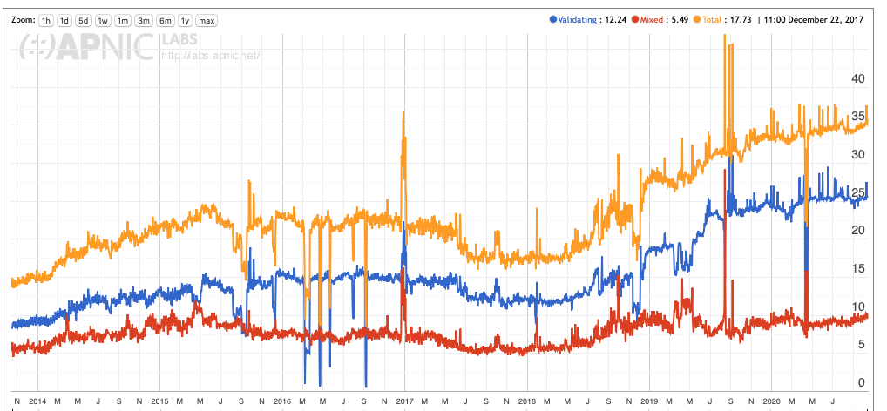
1. DNSSEC – Who uses it?
Add a digital signature to the entries in the DNS zone
Provide the signature along with the resource records in the answer
Validate the signature before using the response data
Those who do it
Those who do it a little

Slide 6
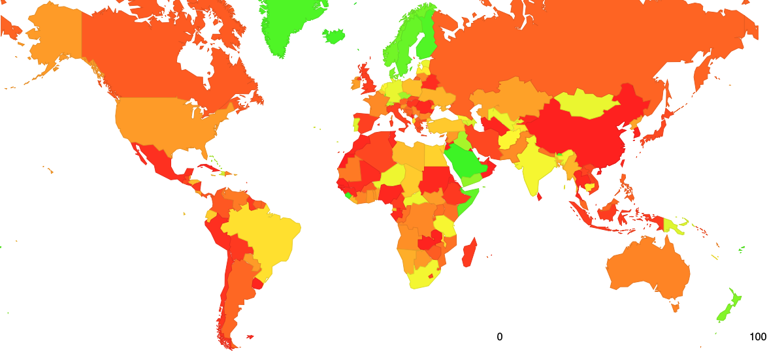
1. DNSSEC – Who uses it?
Add a digital signature to the entries in the DNS zone
Provide the signature along with the resource records in the answer
Validate the signature before using the response data
Those who do it
Those who do it a little

Slide 7
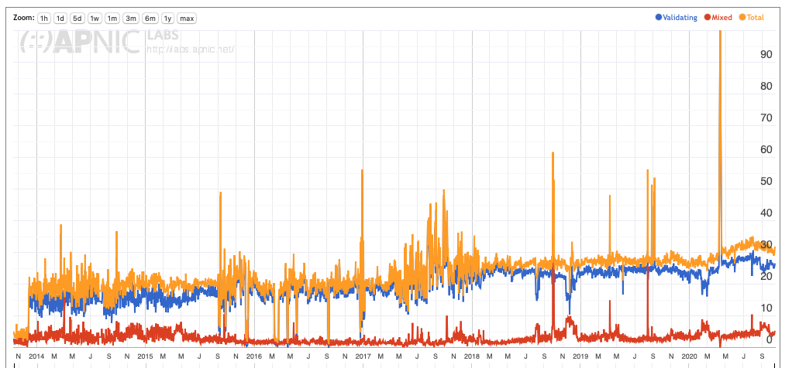
1. DNSSEC validation in Australia

Slide 8
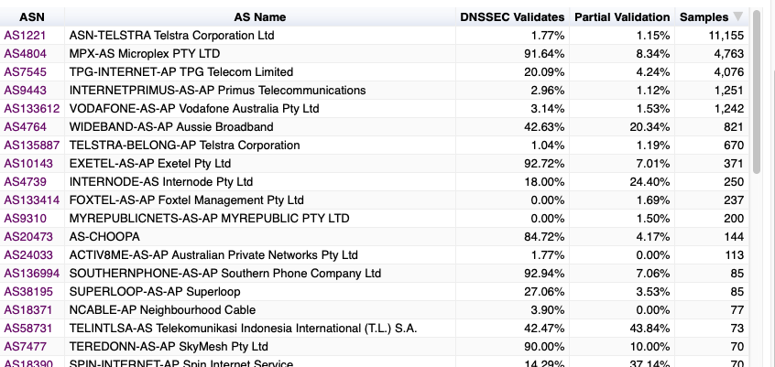
1. DNSSEC validation in Australia
Optus

Slide 9
1. DNSSEC - Registry Tasks
DS record alongside delegation NS records
  Potential use of CDS automated DS tracking from child zone
Zone management
  All-of-Zone signing or dynamic signing?
  Sync of secondary servers
  Using multiple secondary service providers and dynamic signing
Key Management
  Algorithm choice
  Key rollovers
Server Management
  DNS Response Sizes will grow:
    UDP configuration
    TCP capacity
    Large Packet Handling

Slide 10
1. Why Not DNSSEC?
Validation is time-expensive
  Unravel the delegation chain to reproduce the DS/DNSKEY linkages and validate them
  Resolution is slower
  Large responses can be a LOT slower if the DNS needs to kick into TCP to retrieve key records
Its another point of vulnerability
  Poor key management
  Poor management of big DNS responses
End users don’t validate!
  All that effort and no actual protection for end users!

Slide 11
1. DNSSEC has no Use Case!
DANE is a failure!
As long as 75% of user site behind non–validating DNS resolver systems and 99.9% of users don’t directly validate DNS responses then we cannot place critical information in the DNS in a secure fashion and expect everyone to be protected by DNSSEC
No natural market-based incentive for deployment
Which means that Internet security is a failure as well!

Slide 12
2. DNS Privacy
EVERYBODY peeks at the DNS
  Because everything you do online is exposed to the DNS
  And the DNS is promiscuously chatty – it over-exposes information
  DNS query logs are collected, packaged and sold as user profile intel
How can we make the DNS less chatty?

Slide 13
2. Privacy - Resolver Behaviour and Qname Minimisation
Stop over-asking
  Trim the query name to match the scope in the zone you are querying for
  Terminal label query data is only exposed to the zone server that contains the terminal label
Implementations are “approximate”
  Qname minimisation typically is used for the first three labels and then full name is used thereafter

Slide 14
2. Not Privacy - EDNS(0)Client Subnet
DNS does not expose the end user beyond the first recursive resolver
But the DNS is used by a number of CDNs for content steering
The rise of open recursive resolvers increased the distance between the user and the resolver which impacted the accuracy of the DNS-based content steering mechanisms
Add a client subnet to the DNS query which is passed across recursive resolvers
  Massive privacy leak
  Negative impact on caching performance

Slide 15
2. Privacy - DNS Channel Encryption
Stub to Recursive solutions
  DNS over TLS (DoT)
    Replaces UDP and TCP between stub to recursive with TLS/TCP
    Supported on current Android platforms
    Readily blocked (TCP port 853)
    TLS 1.3 with ECH still some time away, so the SNI is still in the clear
    Adds TCP overhead to recursive resolvers (reduces query capacity by around 2/3 at least)
    Used as a platform tool
  DNS over HTTPS (DoH)
    Uses DNS with HTTP framing over TLS/TCP
    Supported on Firefox browsers
    Uses TCP port 443
    Similar TCP overhewad
    Used as an application tool

Slide 16
2. Privacy - DoT implications
Not that many
  Queries and responses are now in a cloaked TLS wrapper, but its little different to DNS as we knew it
It probably won’t take off
  It requires users fiddling with the knobs and users don’t fiddle on the whole

Slide 17
2. Privacy - DoH implications
Allows an application to create its own DNS name resolution context
  No visibility on the part of the user, the platform, other applications
  Which implies that applications can operate in their own application-specific name space
Server push
  “resolverless DNS” where the application is ‘primed’ by a server with DNS response
DoH is NOT secured content – its just secured transit
  People can still lie in the DNS, but now the lie is all but invisible

Slide 18
2. Privacy - Recursive to Server Privacy
Unclear why this is necessary or even useful
Once you’ve shared all your DNS with Google, there is nothing left to see in the path from 8.8.8.8 to the auth servers!
And if you are running your own recursive resolver then getting servers to deal with encrypted sessions seems like a out-of-all-proportion solution to the privacy problem

Slide 19
3 – others: IDNs
Unicode has just one purpose, and that purpose is NOT to encode DNS labels!
  The DNS is largely a “what you see is where you are going” model
  It relies on the property that this is only one way to encode a visible sequence of displayed character glyphs
  This is true in ascii
  Its not true in Unicode – by design
IDNs may be good for a laugh but it’s almost impossible to use in a secure and reliable manner

Slide 20
3 – others:“DNS Abuse”
Moves to replicate the measures for self-regulation in the DNS industry that parallels self-regulation in the banking industry
  But without oversight, without reporting, without legal framework of enforcement
  And it doesn’t work for the banking industry in any case!
DNS registrars and registries are expected to use service contracts that define “acceptable use” and enforce these contracts in their (paying) customers
Unlikely to be successful in reducing the levels of criminal activity in the Internet
“Never mistake motion for progress” some Roman dude a couple of thousand years ago

Slide 21
3 – others: DNS Fragmentation
A perennial topic in name circles
DoH has added a new breath of life to this discussion by lifting the name space out from common infrastructure to application attribute

Slide 22
3 – others: DNS Flattening
Noone really wants to be buried.down.deep.in.the.dns.underneath.some.one.elses.names
They all want to be .myname
The role of the hierarchies in the name space is under constant erosive pressure, and as the top level name space continues to be opened up the price premium of being in the top level drops
It produces an increasing tension between the operators of the tlds and the root zone itself.

Slide 23
3 – others: It’s not about us any more
We have constructed a DNS name infrastructure because we humans communicate using ‘natural languages’
But silicon is multiplying at far higher rates than human populations
And the DNS is a universal signalling and tunnelling protocol
So its pretty logical that the DNS becomes a command and control mechanism of devices, and the residual human use sector becomes an increasingly esoteric luxury good business
The high level of manual handling of DNS names (and cost) during the DNS name lifecycle is unsustainable in the shift from human to automated use
Which implies that the current “high touch” business models of the DNS are close to end-of-life and the new model of crypto-generated bulk names and fully automated instantiation and use are coming
Think of the the DNS as the new HTML – it’s a command and control micro-code language and no longer a distributed database of words intended for human-use

Slide 24
3 – others: Not the DNS any more?
Search terms as the new name space?
Handles?
Name Based Networking – the DNS as a name space but not a resolution protocol

